Slide 1


Telco Customer Churn
Data Analysis on the Customers' churning behavior of the tele communication Services
Stuti Poudel
Bootcamp: UNC-VIRT-DATA-PT-09-2023-U-LOLC-MWTH
Project 1
Date:- 11/20/2023

Slide 2
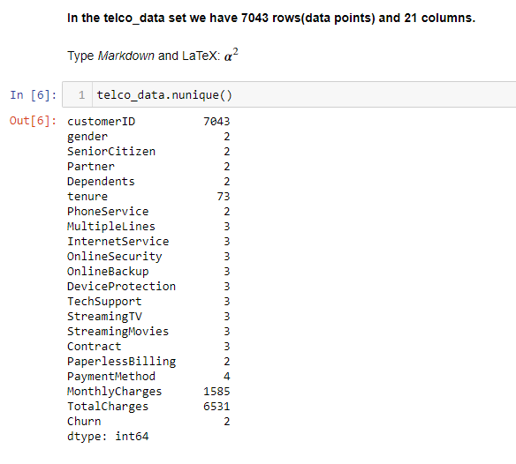
Introduction
This project presents a comprehensive analysis of customer churn within a telecommunications dataset, aiming to discern patterns and indicators that could inform retention strategies.
- Gender
- Streaming TV availability
- Senior Citizen Status
- Tenure
- Contract
- Internet Services
-
-Monthly Charges
-Total Charges
Churn (Yes/No)
Chart 1

Slide 3

Key Questions
Does the high monthly rate and high total charges make more customers churn?
Or there are other factors in the dataset, such as Gender, Streaming TV availability, Senior Citizenship, contracts, and Internet Services that have more vital connection with the churn?
- Gender
- Streaming TV availability
- Senior Citizen Status
- Tenure
- Contract
- Internet Services
-
-Monthly Charges
-Total Charges
This Photo by Unknown Author is licensed under CC BY-NC
Churn (Yes/No)
Chart 1

Slide 4
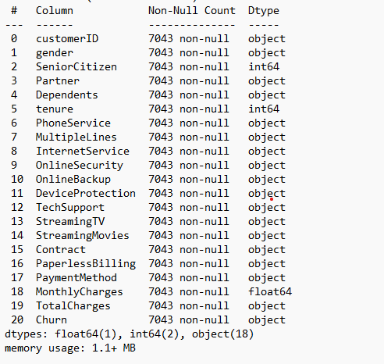
Dataset quick Analysis
In the Telco data set we have 7043 rows(data points) and 21 columns
- numerical columns
Senior Citizen, tenure, and Monthly Charges
- Categorical columns
All other columns, including Total Charges, are listed as string/object data type.
This clean dataset with no null values, is collected from the GitHub page. The link is here posted: https://www.kaggle.com/datasets/blastchar/telco-customer-churn.
Chart 2

Slide 5
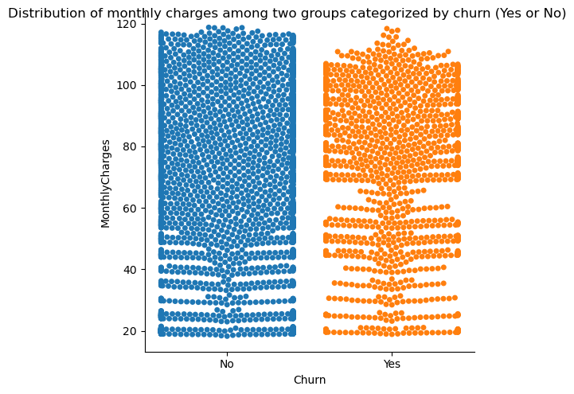
Exploratory Data Analysis
Monthly charges
Distribution of monthly charges among two groups categorized by churn (Yes or No)
No (Didn’t Churn)
Yes (Churn)
More spread out, with a significant portion of data points at the higher end of the monthly charges..
The high density of points tightly distributed approximately in the 50−110 range
Fig 1.
Bee swarm data points indicate variability in monthly charges among both categories of customers.

Slide 6
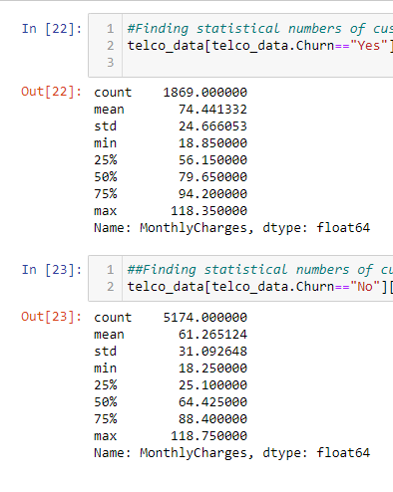
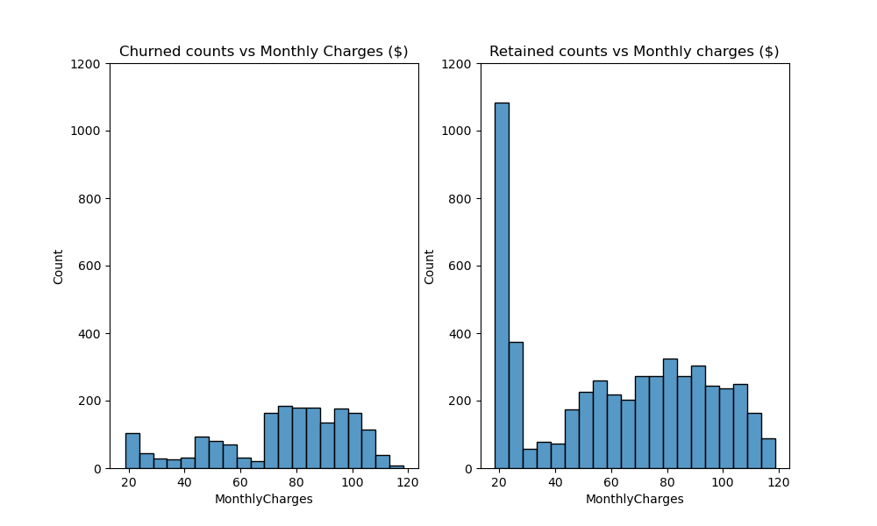
Monthly charges (continued)
The distribution of monthly charges for churned customers is shifted towards higher values than retained customers.
The difference between the mean monthly suggests that. This indicates that churned customers tend to have higher monthly charges on average.
Peak Frequency of most customers who churned have the monthly charges between approx. $ 70-$ 80, whereas most retained customers are between the monthly charges of $ 15-$ 30 which we can see by the tallest bar in the second chart.
chart 3.
Fig 2.
In summary, churned customers tend to have higher monthly charges on average than retained customers.

Slide 7
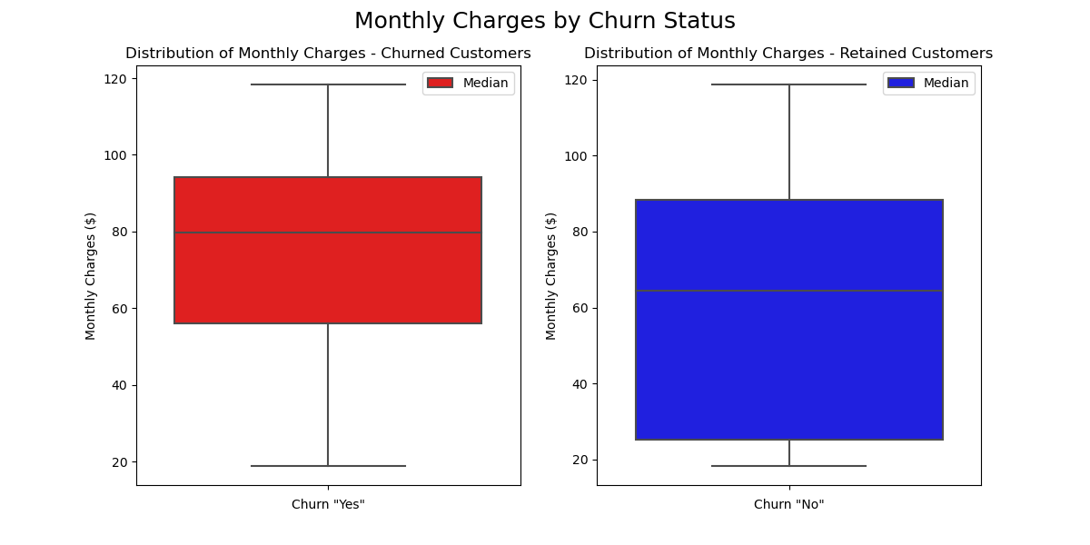
Monthly charges
Monthly charges (continued)
Analysis
The median monthly charge is higher for churned customers ($79.65) than retained customers ($64.43). This reinforces the idea that higher monthly costs are associated with increased churn risk and also suggests that lower monthly charges could be associated with customer retention.
Also, there are no evident outliers in both groups, churned and retained customers, which suggests that both churned and retained customers' monthly charges are relatively consistent within the observed range.
In summary, The IQR for retained customers is greater than the IQR for churned customers, indicating more variability in the monthly charges for retained customers compared to churned customers.
- In summary, more variability in the monthly charges of retained customers suggests regarding pricing flexibility and customization helps retain customers across diverse price points and tolerance levels
fig 3.

Slide 8
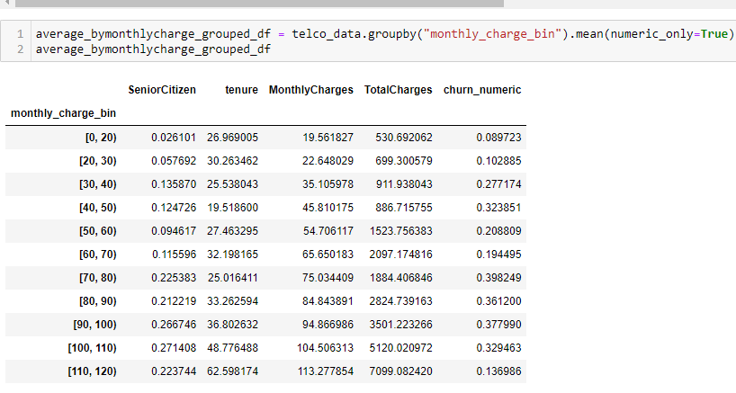
Monthly charges (continued)
- The churn rate is lowest at $ <20 bin which is only 8.97 %.
- Our fig2. at slide # 5 also pointed us that customers who are in the monthly charge bin of around $20 (most affordable service) have the highest retention rate.
- The average monthly spending customers, which falls between $70 - $100, have churned the most, while low and high-spending customers have churned less.
- There is also a notably lower churn rate in the $110 - $ 120 range, suggesting perceived higher value or satisfaction with the service they are receiving, premium or bundled services, hefty cancellation fees, or better or more personalized customer service, and fewer competitive options available for the specific services.
Creating bins in Monthly charges
Chart 3.

Slide 9
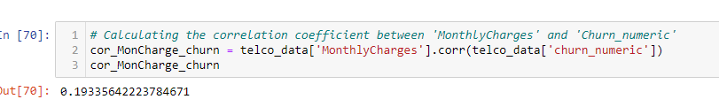
Monthly charges and Churn rate
The correlation coefficient of approx. 0.193 indicates a weak positive linear relationship between the two variables. This suggests that as monthly charges increase, there is a slightly higher likelihood of churn, although the relationship is not strong.
fig 5.

Slide 10
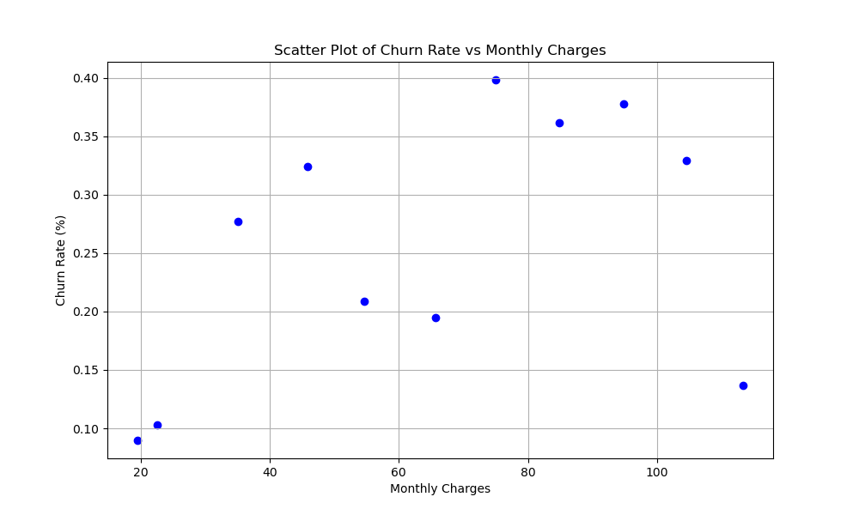
Monthly charges (continued)
Monthly charges and Churn rate
fig 4.

Slide 11
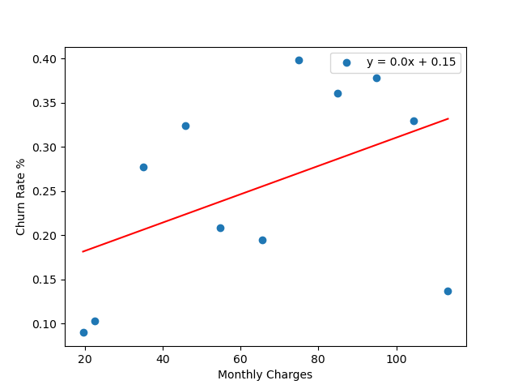
Monthly charges (continued)
Monthly charges and Churn rate
The R-squared value of (approx.) 0.212 from the scatter plot and linear regression analysis indicates a moderate positive relationship, suggesting higher prices may lead to higher churn.
However, The linear regression model explains only about 21% of the variance in churn rate. This indicates that monthly charges are a factor in churn but not the only or most significant one.
- The other 78.8% of the variation is due to other factors.
fig 5.

Slide 12
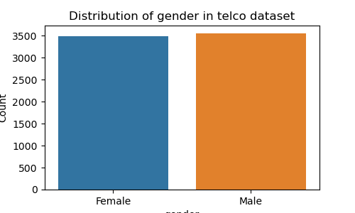
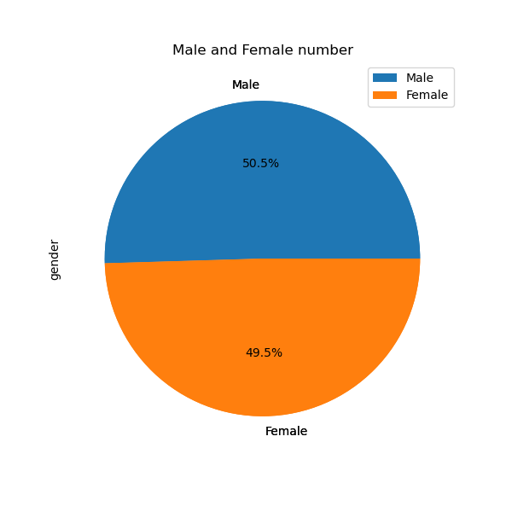
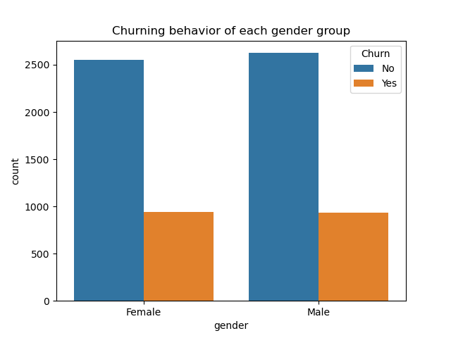
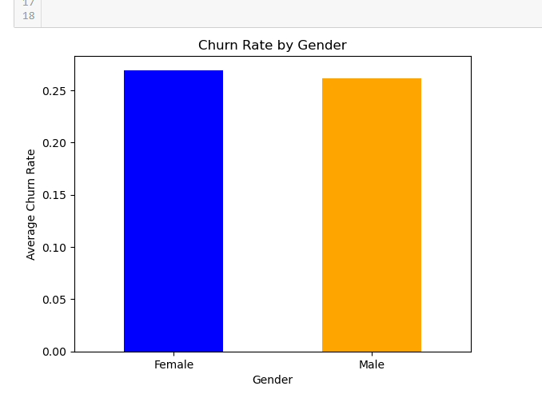
Analysis
Gender
Fig6.
Fig7.
Fig8.
- The Average churn rate for females and males is (approx.) 27% and 26%, respectively, suggesting that the churn rate for both genders is almost identical, suggesting gender not being a strong standalone predictor of churn.
Fig 9.

Slide 13
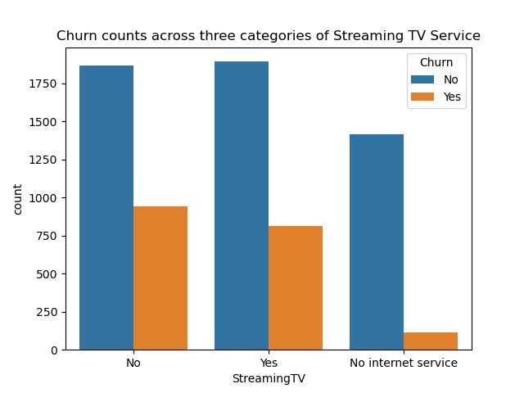
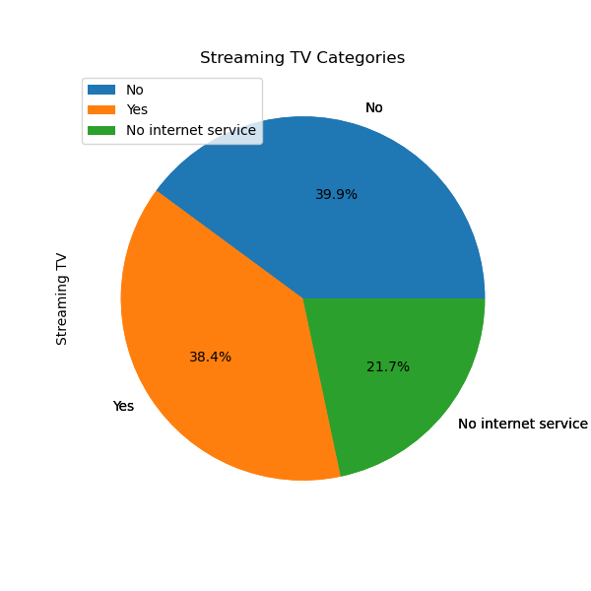
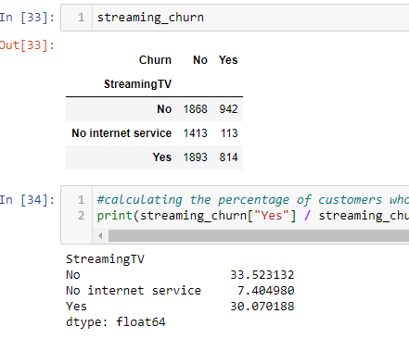
Analysis
Streaming TV Categories
Fig 10.
Fig 11.
- The churning rate is only 33.52 % for customers without Streaming TV and 30% for customers with Streaming TV.
-Likewise, 21.7 % out of all people without internet service, very few of them churned (113 out of 1526), i.e., 7.40%, suggesting these customers with no internet service may be using the telecommunication services for phone lines only.
Chart 4.

Slide 14
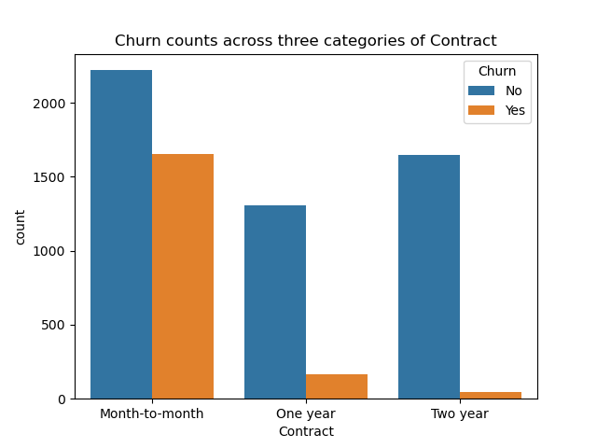
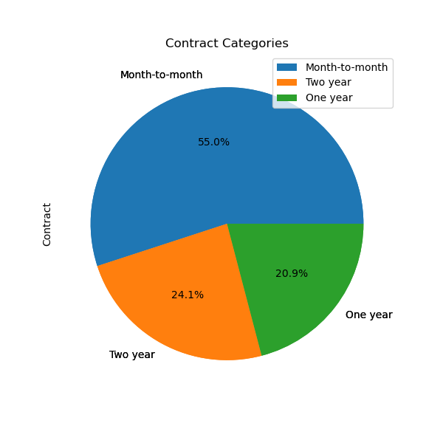
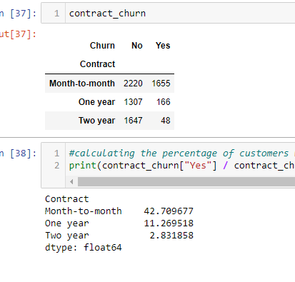
Analysis
Contract Categories
Fig 12.
Fig 13.
- Customers with a month-to-month contract have the highest churn rate, i.e, 42.71%
-And more extended contracts (one year and two years) have significantly lower churn rates, with the two-year contract holders being the least likely to churn (2.83%).
The highest month-to-month churn rate could reflect a commitment level or satisfaction with the service,
unaffordability of services for a more extended period, end of promotions and trial periods, life changes, etc.
Chart 5.

Slide 15
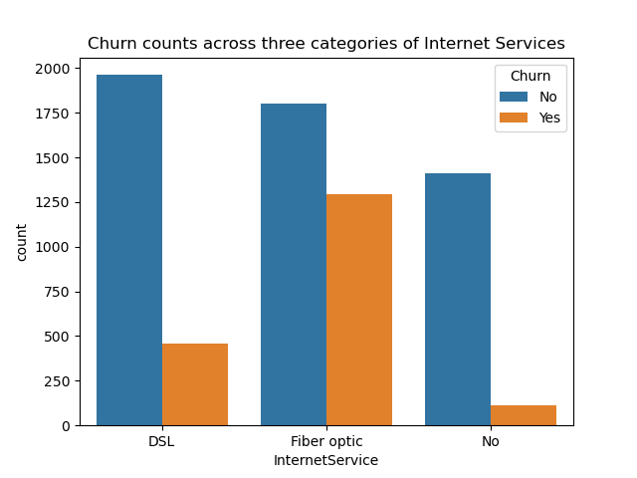
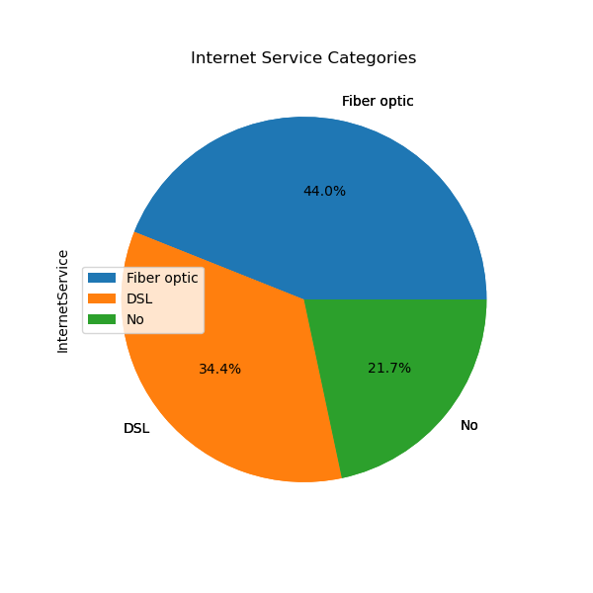
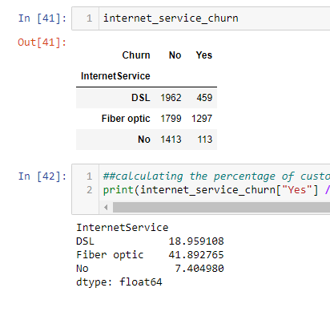
Analysis
Internet Service Categories
Fig 14.
Fig 15.
- Fiber Optic has the highest churn rate, i.e., 42%.
- Customers with No internet service have the lowest churn rate at only 7.
This suggests issues around fiber optic services driving churn or customers getting fiber, expecting faster speeds but being disappointed. The provider could improve fiber optic performance and customer satisfaction to reduce churn.
Chart 6.

Slide 16
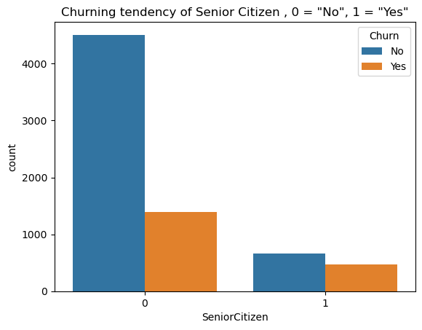
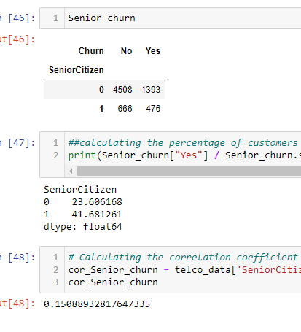
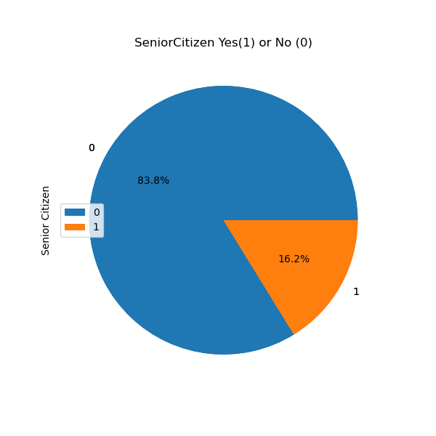
Analysis
Senior Citizen status
Fig 17.
Fig 16.
chart 7.
- Senior citizens (65+ years old) are notably churning at a higher rate (41.68%) than non-senior citizens (23.61%) which is almost double.
- The smaller number (16.2%) of senior citizens in the dataset could mean we didn’t collect enough data from the senior citizen population. At the same time, their higher churning rate suggests that they may need additional retention efforts, special offers, or customized service to reduce their churn rate.
- However, the value of (approx.) 0.15 of the correlation coefficient indicates a weak but positive correlation between being a senior citizen and churning, suggesting that other factors may be more responsible for the customers' churning behavior.
-

Slide 17
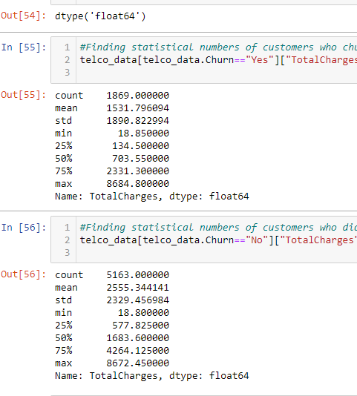
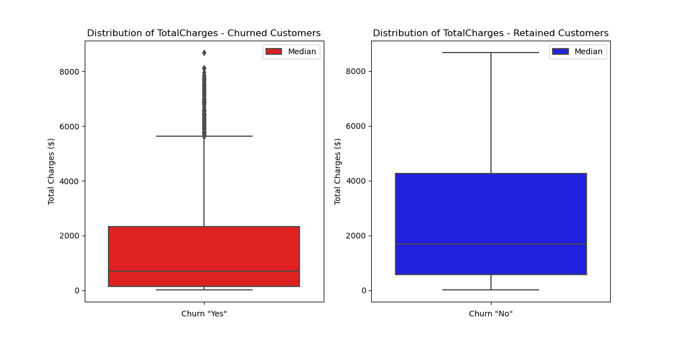
Analysis
Total Charges
Fig 18.
Chart 8.
- The median total charges for Churned customers are lower than retained customers ( 703.55 < 1683.60).
- The interquartile range (IQR), represented by the length of the boxes, seems to be wider for retained customers, suggesting more variability in the total charges among customers who have not churned, which is also the case with monthly charges as shown in slide 6 (fig3.)
The outliers among churned customers suggest that while the median total charge is lower, several customers still had very high total charges(extreme values). The absence of outliers in the retained customer box plot suggests a more uniform distribution of total charges without extreme values, suggesting customers within a specific range of spending are more likely to stay, which could be a sign of stable usage patterns and satisfaction with the service among these customers, possibly because they find the services to be of good value or due to the costs associated with switching to another provider.

Slide 18
Observations and suggestions
1. With respect to "Monthly charges“, there is a weak positive linear relationship (0.193) between monthly charges and churn rate. Also, the R-squared value of (approx.) 0.212 indicates the strength of the relationship; it would also be essential to consider the p-value associated with the regression analysis to understand whether the observed relationship is statistically significant.
Suggestions: There could be other factors influencing churn that are not included in the model. These might include customer service quality, contract terms, competitive offers, individual customer preferences, and market conditions.
2. With respect to the “Internet Services” category, Fiber Optic has the highest churn rate, i.e., 42%. suggesting issues around fiber optic services. The provider could improve fiber optic performance and customer satisfaction to reduce churn.
Suggestions: Improving fiber optic satisfaction and analyzing the root causes of dissatisfaction among fiber optic customers could reveal ways to improve retention.

Slide 19
Observations and suggestions
3. With respect to “Contract” categories, approx. 42.71% of customers with a month-to-month contract have churned, compared to (one year and two years), with the two-year contract holders being the least likely to churn(2.83%).
Suggestions: The highest month-to-month churn rate could reflect the lowest commitment level, lower satisfaction, end of promotions and trial periods of the services, life changes, etc. Customized price levels ensuring higher quality ensuring customer satisfaction may help businesses retain more customers.
4. With respect to “Total Charges:” The significant presence of outliers among churned customers suggests that while the median total charge is lower, several churned customers still have very high total charges. The more consistent range of total charges among retained customers could indicate that customers within a specific spending range are more likely to stay.
Suggestions: The company might want to investigate why customers with high total charges are leaving and address those reasons to improve retention.
5. With Respect to “Senior Citizen”: The churn rate is almost double for senior citizens versus non-seniors (41.68% >23.60%) even though seniors are only 16.2% of the total customers in the dataset.
Suggestions: The smaller number of senior citizens in the dataset could mean we didn’t collect enough data from the aging population. At the same time, their higher churning rate suggests that they may need additional retention efforts, special offers, or customized services to reduce their churn rate.
Conclusion
In conclusion, different variables undoubtedly have marginal effects on our variable “Churn.” However, it is also crucial to acknowledge that the interactions between these variables can influence churn in reality.

Slide 20
Questions?

Slide 21

Thank you!
Stuti Poudel​
XXX-XXX-XXXX
Stuti.poudel@outlook.com

